Slide 1
Chapter 1
Introduction to Database and Database Users

Slide 2
Outline
Database Introduction
An Example
Characteristics of the Database
Actors on the Scene
Advantages of using the DBMS approach

Slide 3
Database Examples
Database is involved like everywhere in our world
For example:
  If we go to bank to deposit or withdraw
  Make hotel and airline reservation
  Purchase something online
  Buy groceries in supermarkets

Slide 4
Database Applications
These examples are what we called traditional database applications
(First part of book focuses on traditional applications)
More Recent Applications:
  Multimedia Databases (like Youtube)
  Geographic Information Systems (GIS)
  Data Warehouses
  Real-time and Active Databases (OLAP)
  Many other applications

Slide 5
Database System
Database:
  A collection of related data.
Data:
  Known facts that can be recorded and have an implicit meaning.
Database Management System (DBMS):
  A software package/system to facilitate the creation and maintenance of a computerized database.
Database System:
  DBMS + Database

Slide 6

Simplified database system environment

Slide 7
An UNIVERSITY example
A UNIVERSITY database for maintaining information concerning students, courses, and grades in a university environment
We have:
STUDENT file stores data on each student
COURSE file stores data on each course
SECTION file stores data on each section of each course
GRADE_REPORT file stores the grades that students receive
PREREQUISITE file stores the prerequisites

Slide 8
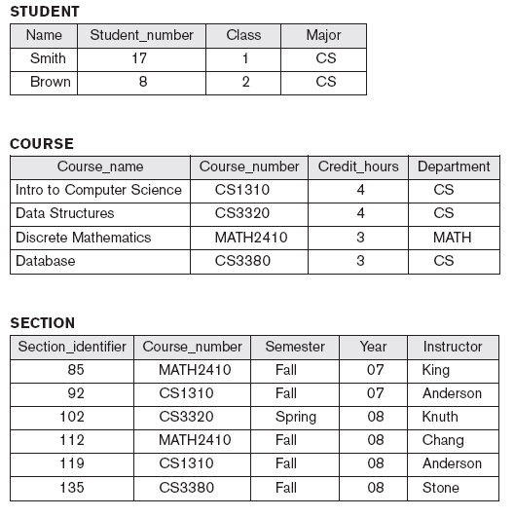
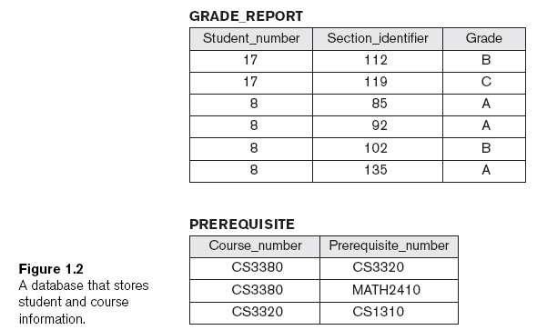
Example of a simple database

Slide 9
Typical DBMS Functionality
Define a particular database in terms of its data types, structures, and constraints
Construct or Load the initial database contents on a secondary storage medium
Manipulating the database:
  Retrieval: Querying, generating reports
  Modification: Insertions, deletions and updates to its content
  Accessing the database through Web applications

Slide 10
Database manipulation
Database manipulation involves querying and updating
Examples of querying are:
  Retrieve a transcript
  List the prerequisites of the “Database” course
Examples of updating are:
  Enter a grade of “A” for “Smith” in “Database” course

Slide 11
Outline
Database Introduction
An Example
Characteristics of the Database
Actors on the Scene
Advantages of using the DBMS approach

Slide 12
Database V.S. File
In the database approach, a single repository of data is defined/maintained once then accessed by various users
The major differences between DB and File are:
  Self-describing of a DB
  Insulation between programs and data
  Support of multiple views of the data
  Sharing of data and multiuser transaction processing

Slide 13
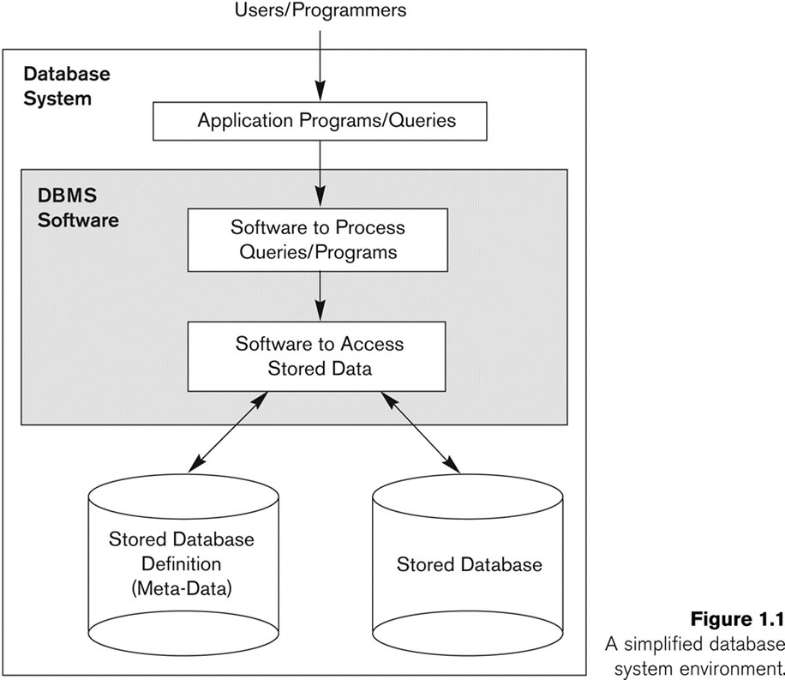
Self-describing nature of a database system
Database system contains not only the database itself but also a complete definition of the database structure and constrains
The information stored in the catalog is called Meta-data (data about data), and it describes the structure of the primary database.

Slide 14

Example of a simplified Meta-data

Slide 15
Insulation between programs and data
In file processing, if any changes to the structure of a file may require changing all programs that access the file
In database system, the structure of data files is stored in the DBMS catalog separately from the access program
This is called program-data independence

Slide 16
Support of multiple views of the data
Each user may see a different view of the database, which describes only the data of interest to that user
It may also contain some virtual data that is derived from the database files but its not explicitly stored

Slide 17
Sharing of data and multi-user transaction processing
Allowing a set of concurrent users to retrieve from and to update the database.
Concurrency control within the DBMS guarantees that each transaction is correctly executed or aborted
  For example, when several reservation clerks try to assign a seat on an airplane flight
  (these types of applications are generally called online transaction processing (OLTP))

Slide 18
Outline
Database Introduction
An Example
Characteristics of the Database
Actors on the Scene
Advantages of using the DBMS approach

Slide 19
Database Users
  Database administrators:
    Responsible for authorizing access to the database, for coordinating and monitoring its use, acquiring software and hardware resources, controlling its use and monitoring efficiency of operations.
  Database Designers:
    Responsible to define the content, the structure, the constraints, and functions or transactions against the database. They must communicate with the end-users and understand their needs.
  End Users
  System Analysts

Slide 20
End Users
Casual: access database occasionally by sophisticated query language when needed.
(Manager)
Naïve: or Parametric: they make up a large section of the end-user population. Learn only a few facilities that they may use repeatedly
(bank clerk)
Sophisticated: These include business analysts, scientists, engineers, others thoroughly familiar with the system capabilities.
Stand-alone: Normal users

Slide 21
Workers Behind the Scene
  DBMS system designers
  Tool developers
  Maintenance personnel

Slide 22
Outline
Database Introduction
An Example
Characteristics of the Database
Actors on the Scene
Advantages of using the DBMS approach

Slide 23
Controlling Redundancy
Controlling Redundancy is one of most important feature to use DBMS
The traditional file approach, each group independently keeps their own file.
  For example: accounting office keeps data on registration and billing info; whereas the registration office keeps track of registration, student courses and grades.

Slide 24
Controlling Redundancy
This redundancy in storing the same data multiple times leads to several problems:
  Logic update – we need to update several times
  Storage space is wasted
  The file that represent the same data may become inconsistent

Slide 25
Other Advantages of using the DBMS approach
Restricting unauthorized access to data
Providing Storage Structures (e.g. indexes) for efficient Query Processing
Providing backup and recovery services

Slide 26
Other Advantages of using the DBMS approach
Providing multiple interfaces to different classes of users
Representing complex relationships among data
.
.
.

